Slide 1
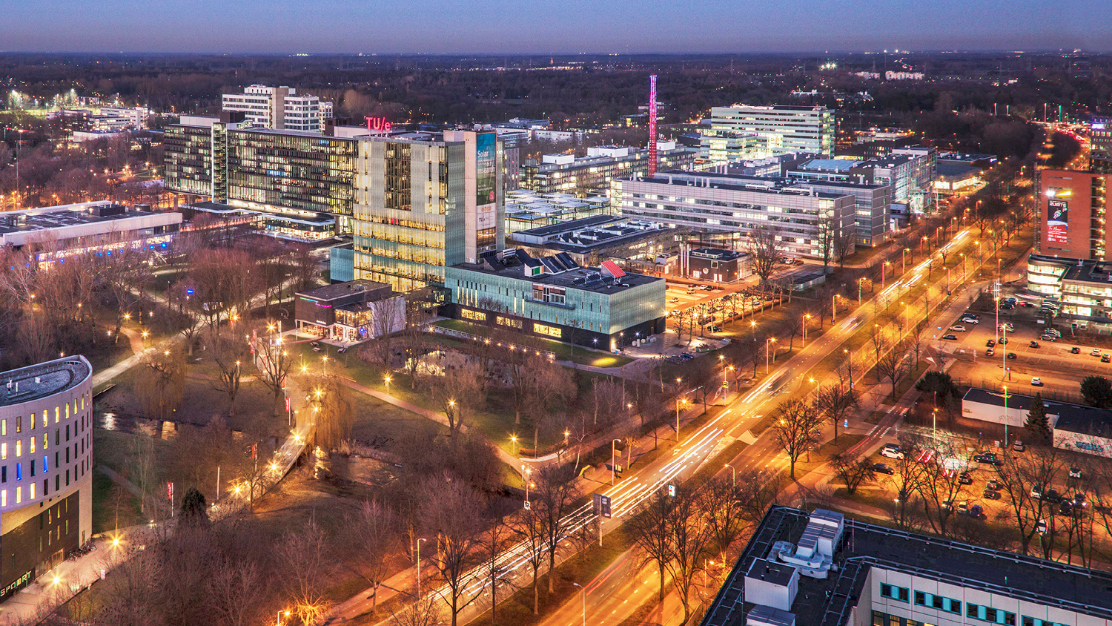
The experimental plan + report work
23-02-2021
Thomas Driessen - 1262084
Group 007, Combustion engine

Slide 2
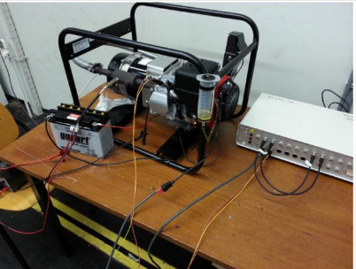
Step 1
Measurements of experiment 1
Bore
Stroke
Connection rod
Dead volume
Timing of ignition
Valve timing

Slide 3
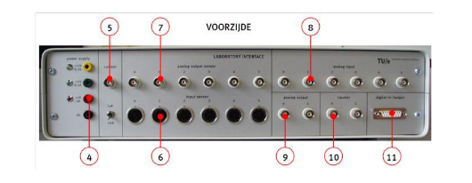
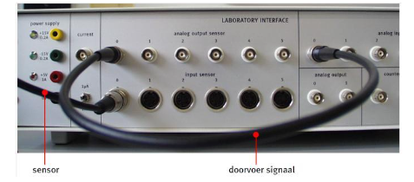
Step 2
Checklist before measuring
Main supply
Power supply (red +5V, black ground)
Current source
Sensor power supply
Analog output connection analog input
Counter connection

Slide 4
Step 3
The measuring
Gasoline
E5
E10
E15
No load, half load and full load

Slide 5
Report work
Introduction changed
Thermodynamics
Fuels (Dolf)
Next steps:
Experimental plan
Analyse measurements

